Slide 1
MERIT beam intensities
A. Fabich, CERN
MERIT collaboration meeting, CERN, 7-8 February 2008

Slide 2
Contents
Aim:
Single bunch intensities
Relative precision of a few percent
  Must be better than the aimed precision for detecting production deficiencies due to cavitation.
Beam intensity monitors
Data synchronization
MERIT BCT data and analysis
PS transformer data
Self-contained analysis and comparison of different systems

Slide 3
Beam intensity monitors
BSM
  Bunch shape measurements in the PS ring
  On last turn before extraction
  Single bunch intensities available
  Not always recorded, data stored graphically
BeamCurrentTransformers (PSCT) on TT2
  Pulse intensities measured, no single bunch intensities
  “wrongly” measured intensities for pulses in pump-probe method beyond a certain delay
  Automatic logging (data electronically available)
MERIT BCT on TT2A (MCT)
  About 10 meter upstream of z=0
  Single bunch intensities available
  500 MHz (2 ns) sampling rate
  Attenuation factor was increased once on 26.Oct 2008 at 16:03 (BCT time)
  Automatic logging (data electronically available)

Slide 4
The crux of the matter is in the details ....
which takes a long time to analyse
...

Slide 5
Step 1 – Synchronize data
Sources with different data management and timing systems
Ilias prepared a file with all major parameters combined with beam run numbers.
  MERIT logbook and beam run numbers
  PS logging system (PSCTs, B-fields ...)
    UTC time (2 hour off, 1 hour off after 28th Oct. 2007) compared to CERN time GMT+1)
MERIT BCT, stand-alone server (with different day-light adjustments than usual)
Mercury system
Particle detector systems
For the case of beam intensities:
Satisfactory!
  Minor discrepancy, where the discrepancy has other origins than timing synchronization.

Slide 6
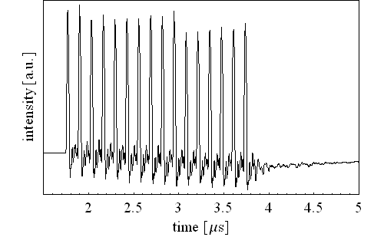
A typical MCT recording
Bunch (h16)
drift - offset
Ringing

Slide 7
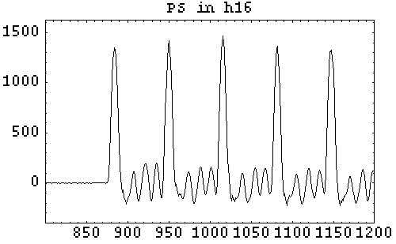
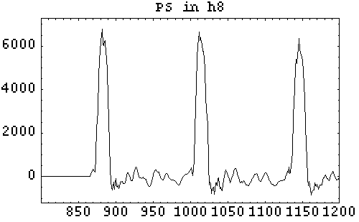
PS in different harmonic modes

Slide 8
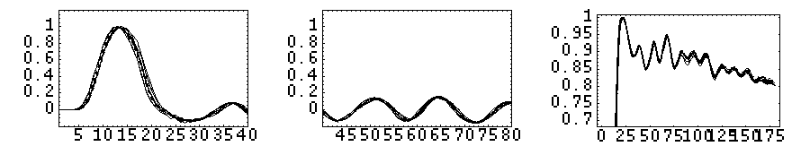
Single pulse response
All single h16-bunches
normalized to unity.
Time shifted
Left: start of MCT response
Center: ringing up to “next” bunch
Right: Numerical integral

Slide 9
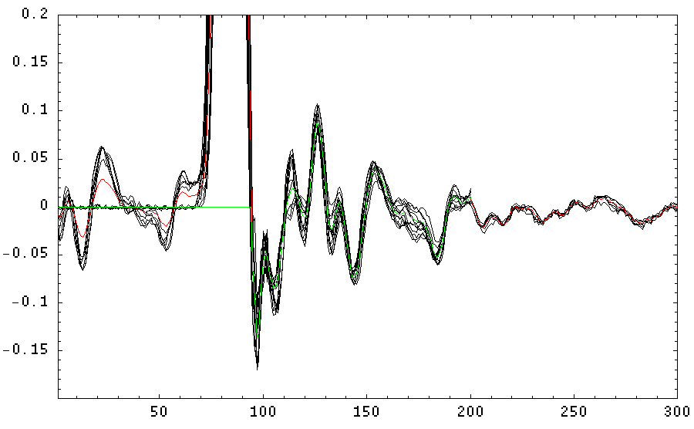
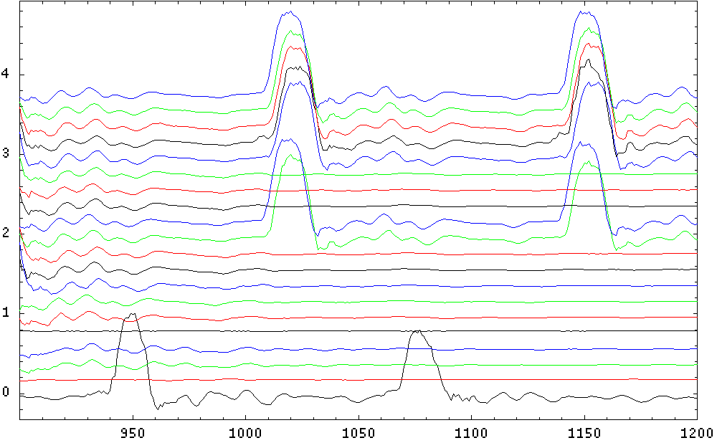
“Single” pulses – h8

Slide 10
Analysis – step by step
Any beam taken (in fact 2007-10-31,10:00:52 transformer time)
  harmonic 16
  16 bunches
  NO pump-probe; extraction within one turn
Raw integral

Slide 11
Reconstruct with single pulse response
(single pulse from 2007-10-29 16:20:51)

Slide 12
The intensity integral

Slide 13
Comparison PSCT - MCT
Right:
  red and green = PSCT (scaled)
  Black: ratio MCT/OSCT
Left: Histogram of black data from right
  Peak at 1 is reasonable
  Some strange peaks and flat distributions
  Peak at 0.25 and 0.5 from “wrong” measurements by PSCT in pump-probe

Slide 14
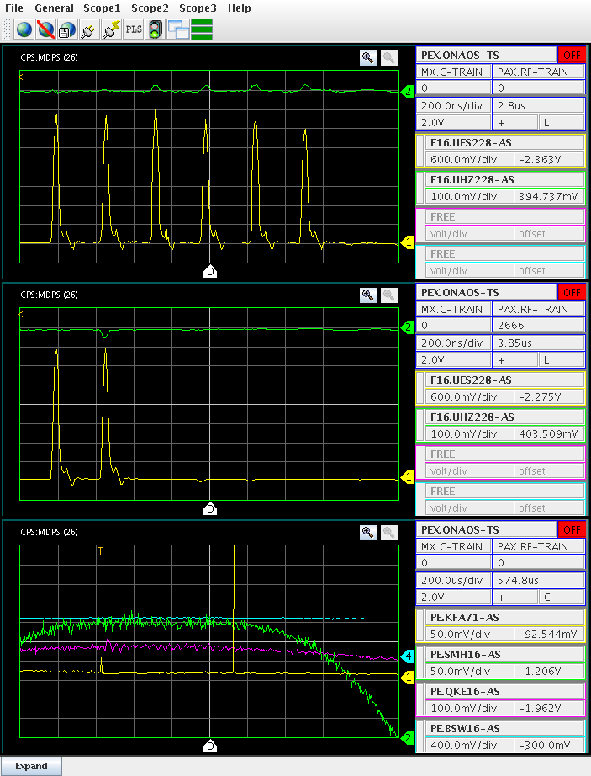
BSM data
Right: BSM
Below: superposition
  of BSM and MCT

Slide 15
BSM summary
Pulse total from single bunch recordings of BSM and MCT are compared.
Poor statistics from BSM (to be verified).

Slide 16
Summary
Analyzed about 500 beam measurements
Revisit intensity from PSCT for “strange” cases
Codes (mathematica) available for automated analysis available
Summary sheet of all single bunch intensities available
  Need to add flag of good/bad beams
  If “bad” beam run is needed, has to be evaluated case-by-case.
Re-evaluate BSM data

